Slide 1


Anterior Segment Urgent Cases & Emergencies

Slide 2

Thank You!
Rakhee Price
Sid Maher
Ankur Trivedi
Simone Mason
Peter Greedy
Nigel Harris
Jo Dean
And all at GLOS LOC

Slide 3

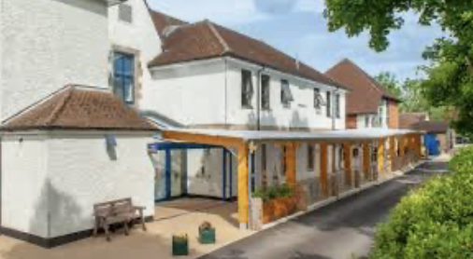
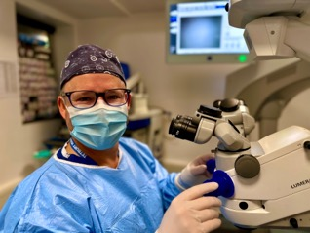
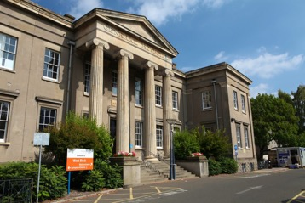
Mr Will Dean PhD FRCOphth MEd MBChB Bsc
Consultant Ophthalmic Surgeon
Gloucestershire Hospitals NHS Foundation Trust
Tetbury Hospital Trust
Private Clinics and Cataract Surgery in Cheltenham and Tetbury
contact@cotswoldcataract.co.uk
William.Dean2@NHS.net

Slide 4
Cornea/ External Eye | HSK | 56 | Uveitis | AAU | 80
 | CLRK | 55 | Oculoplastics | Preseptal cellulitis | 20
 | FB | 48 | Glaucoma | Pupil block | 5
 | DED | 47 | Trauma | Chemical injury | 31
 | Other keratitis | 31 |  | Blunt trauma | 24
 | HZO | 30 |  | Hyphaema | 12
 | Marginal keratitis | 28 | Cataract | Cataract | 17
 | Graft related | 26 |  | PCO | 8
 | Abrasion | 26 | Retina | PVD | 135
 | Conjunctivitis | 20 |  | VH | 32
 | Rust ring | 15 |  | Retinal tear | 23
 | Episcleritis | 13 |  | RRD | 15
 | Blepharitis | 12 |  | AMD | 11
 | Scleritis | 9 |  | RVO | 9
 | SCH | 8 |  | RAO | 5
 | Allergic eye disease | 7 | Neuro | Papilloedema | 15
 | Pingueculum/ pterygium | 7 |  | Migraine | 12
 | Limbal stem cell failure | 6 |  | CN palsy | 11
 | RCES | 5 |  | GCA | 8
 | Trichiasis | 5 |  | Optic neuritis | 7

Slide 5
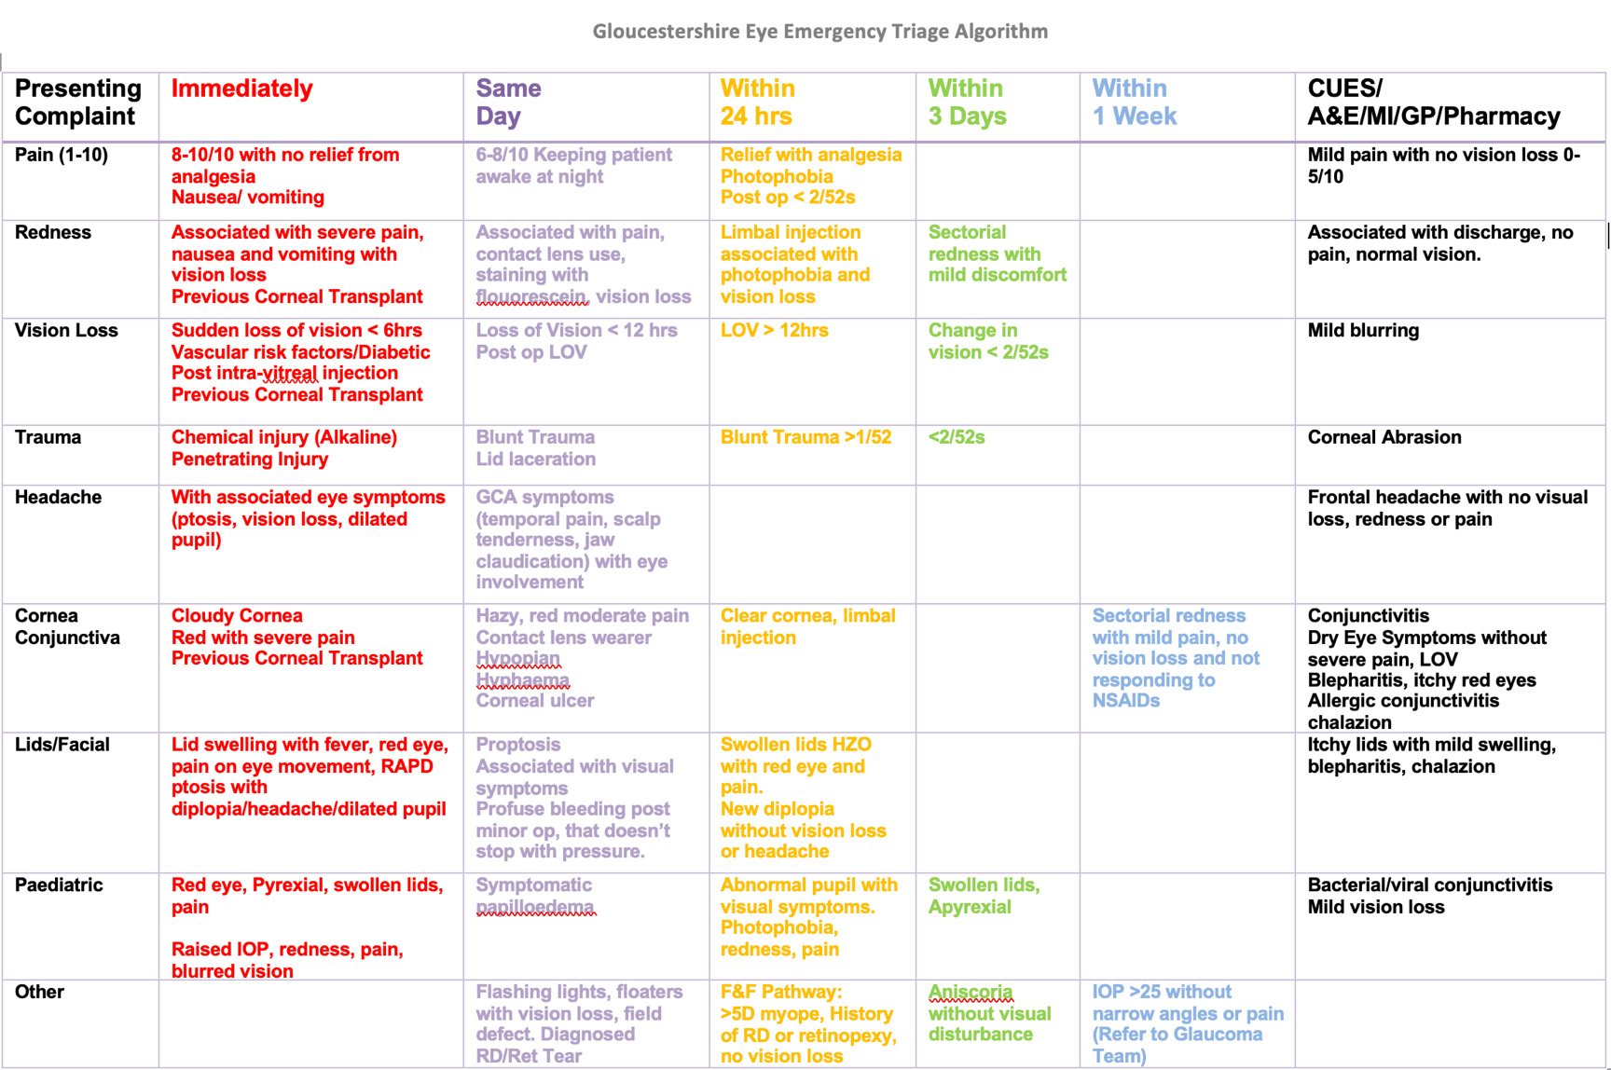

Slide 6

What are the ‘RED FLAG’ anterior segment conditions that need immediate referral within the hour or immediate to A&E?

Slide 7
Blinding Emergency Conditions
Penetrating Eye Injury
Chemical injury (alkali)
Endophthalmitis
Acute angle-closure glaucoma
Others include orbital compartment syndrome

Slide 8
Penetrating Eye Injury
What are the key diagnostic features?
What immediate (first aid) management?

Slide 9
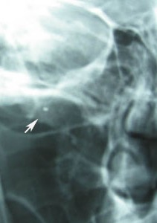
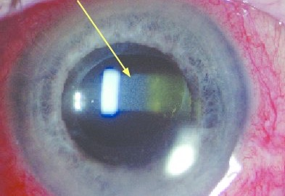
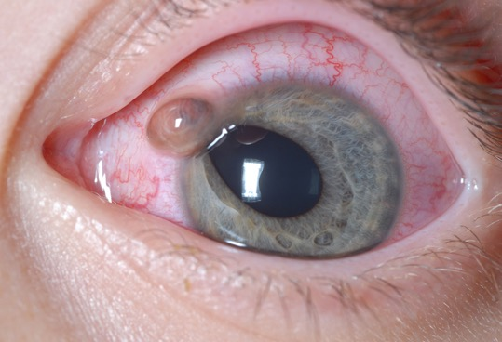
Penetrating Trauma
Assessment
Clinical features
Toxicity and IOFB
Treatment
General
Primary repair
Secondary repair
IOFB removal
Sympathetic ophthalmia
Rare, severe bilateral granulomatous panuveitis (autoimmune inflammation).
Occurs after penetrating trauma (or surgery) to one eye (exciting eye), which subsequently causes inflammation in the uninjured eye (sympathizing eye).
Causes symptoms like decreased vision, pain, photophobia, and floaters, typically within one year of injury.
Prompt treatment with systemic corticosteroids is essential to preserve vision.

Slide 10
Chemical Injury
What is the first aid management (anywhere)?

Slide 11
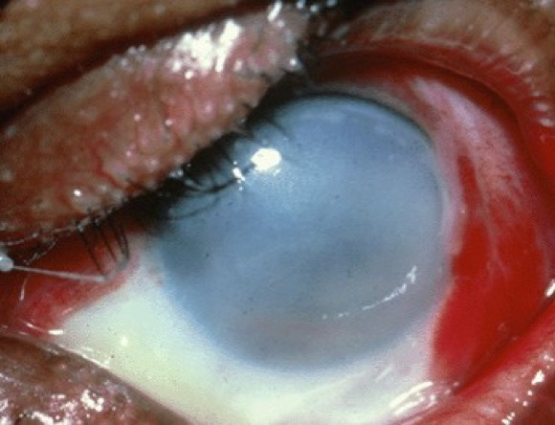
Chemical Injury
Assessment
Clinical features
Classification
Complications
Treatment
Immediate
Acute
Long term

Slide 12
Endophthalmitis
What is the KEY diagnostic feature?
When is it most common after cataract surgery?

Slide 13
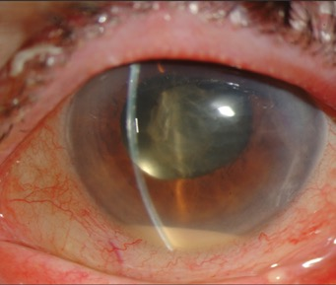
Endophthalmitis

Slide 14
Acute Angle-closure Glaucoma
How does this present (clinical history)?
What can you typically see on the slit lamp?

Slide 15
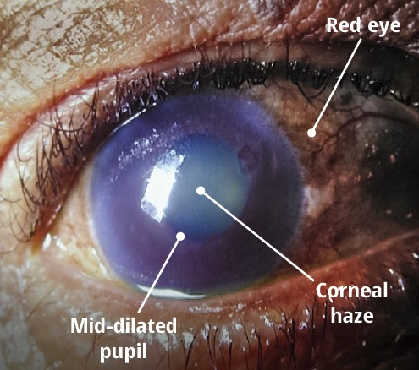
Acute Angle-closure Glaucoma

Slide 16
Primary angle
closure

Slide 17
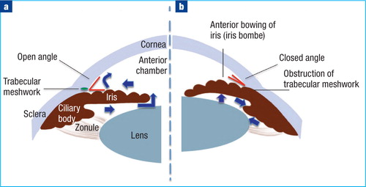
Primary
Angle closure
Occlusion of the Trabecular Meshwork by the peripheral iris (irido-trabecular contact /ITC) obstructing the aqueous outflow
Acute angle closure is an ophthalmic emergency
PACS -> PAC -> PACG
75% due to pupil block
Risk Factors
• Age (mean age of diagnosis is 60 years)
• Female gender
• Hypermetropia
Ethnicity (Far East, and South-East Asia)
Some Medication (mydriatics, Atrovent, Topiramate, SSRI)

Slide 18
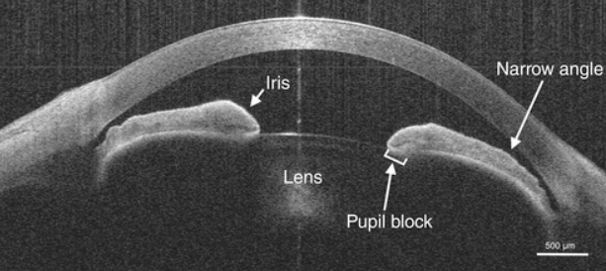
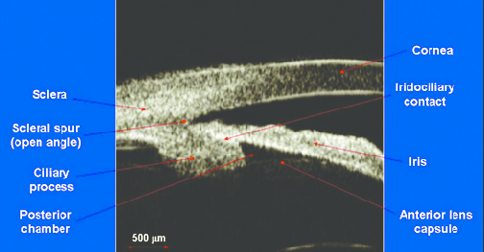
Primary
Angle closure
Pupil block mechanism
Narrow angle, shallow AC
relatively anterior iris–lens diaphragm
large lens (older, cataract)
short axial length (usually hypermetropic)
risk increases with increasing lens thickness to axial length ratio
Plateau iris mechanism
Plateau iris configuration: flat central iris plane and normal central AC depth
The angle recess is very narrow, with a sharp iris angulation over
anteriorly positioned and orientated ciliary processes

Slide 19
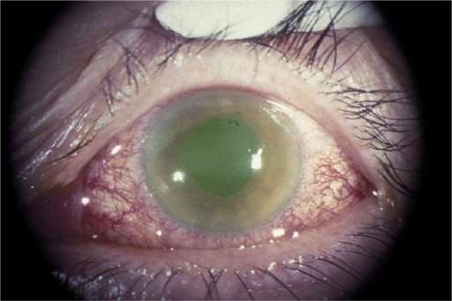
Primary
Angle closure
PAC signs & symptoms
Symptoms
Pain (periocular pain , frontal headache)
Blurred vision, haloes around lights
Nausea, vomiting
can be asymptomatic
Signs
Red eye, ciliary congestion
Fixed mid-dilated pupil
Reduced VA
Raised IOP (usually 50 to 80mmHg)
Corneal oedema
Angle closed and occludable angle in fellow eye
Glaucomflecken

Slide 20
Management
Primary
Angle closure
Diamox (Acetazolamide) 500mg PO and/or IV
G. Pilocarpine 2% stat and then QDS to - BOTH EYES
To the affected eye / eyes:
G PredForte 1% stat and QDS (or more frequent based on AC inflammation)
G Apraclonidine (Iopidine) 1% stat and every 15 minutes until IOP<30mmHg then TDS
G Latanoprost stat
G Timolol 0.5% BD (ask contraindications for ß blocker) or G Cosopt
YAG laser peripheral iridotomies (PIs) both eyes
Also consider:
Indentation Gonioscopy with a 4-mirror goniolens may help relieve pupil block
Lying the patient supine
Analgesics and anti-emetics may be necessary
If IOP not improving:
Consider systemic Hyperosmotics (Glycerol PO/ Mannitol IV)

Slide 22
Conjunctivitis
Features – Viral vs. Bacterial vs. Allergic
Initial Management
Lubricants, avoid contamination
Chloramphenicol 0.5% drops / 1% ointment
Sodium Chromoclycate, Olapatadine (Opatonol)
RED FLAGS – contact lens wear

Slide 23
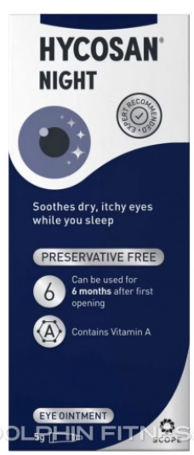
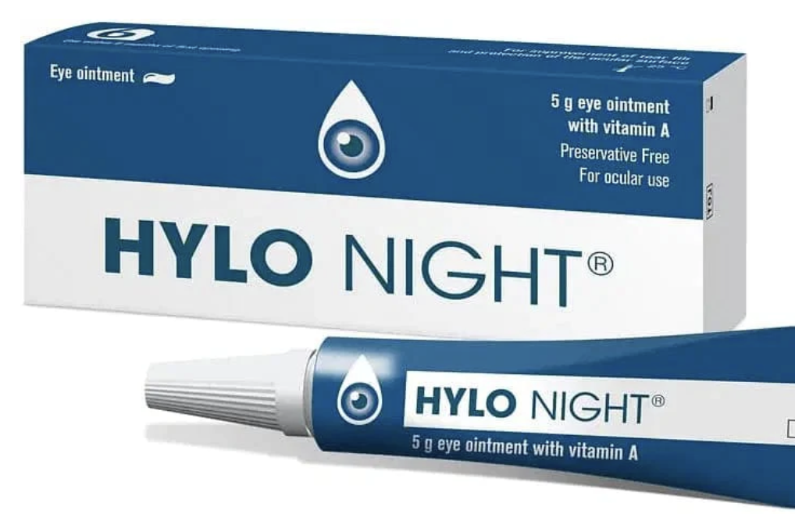
Corneal Abrasion
Initial management
How do you prevent recurrent corneal erosion syndrome?

Slide 24
Dry Eyes
Common, but not always simple
What is the first line of treatment?

Slide 25
GHNHS Dry Eye Guidelines. (Thanks to Mr Tomlins)
The spectrum of dry eye disease (DED) varies from a mild, self-limiting, irritation to severe, sight-threatening disease. The quality of life impact of moderate DED compares to that of life on haemodialysis or with mild angina
Dry Eye disease is classified into:
Evaporative Dry Eye Disease, where there is poor tear function, usually due to blepharitis or Meibomian Gland Dysfunction
Aqueous Deficiency Dry Eye disease, where there is insufficient tear production

Slide 26
Triaging Dry Eye DiseaseTriage
Mild | Soreness, irritation, discomfort | Negligible impact on the vision | Temporary treatment 1-2 x day with OTC drops
Moderate | Increased discomfort | Transient blurring of vision | Long-term use of drops 4 or more times per day
Severe | Marked discomfort or pain | Reduction in vision | Use of drops every 1-2 hours

Slide 27
Moderate to Severe Dry Eyes - Drops
Product | Active ingredient(s) | Unit Price* | Comments
Evolve HA® | Sodium hyaluronate 0.2% | £5.99 (10ml)
Clinitas Multi® | Sodium hyaluronate 0.4% | £6.99 (10ml)
Thealoz Duo® | Sodium hyaluronate 0.15%, treahalose 3% | £8.99 (10ml)
Systane Balance® | Propylene glycol 0.6% | £7.49 (10ml) | In Evaporative Dry Eye Disease with blepharitis/meibomian Gland Dysfunction
VisuXL® | Sodium hyaluronate 0.1%, co-enzyme Q10 0.1%, vitamin E 0.5% | £10.30 (10ml) | If Chronic Keratitis
Ilube® | Acetylcysteine 5%, hypromellose 0.35% | £33.46 (10ml) | If Filamentary Keratitis Specialist initiation only

Slide 28
Moderate to Severe Dry Eyes - Ointments
Product | Ingredient(s) | Unit Price* | Comments
Hydramed Night® | Retinol palmitate 250iu/g, liquid paraffin, white soft paraffin, wool fat | £2.32 (5g)
Xailin Night® | White soft paraffin, white mineral oil, lanolin alcohols | £2.54 (5g)
Hydramed Night Sensitive® | Retinol palmitate 250iu/g, liquid paraffin, white soft paraffin (lanolin free) | £8.34 (5g) | Patients with lanolin allergy

Slide 29
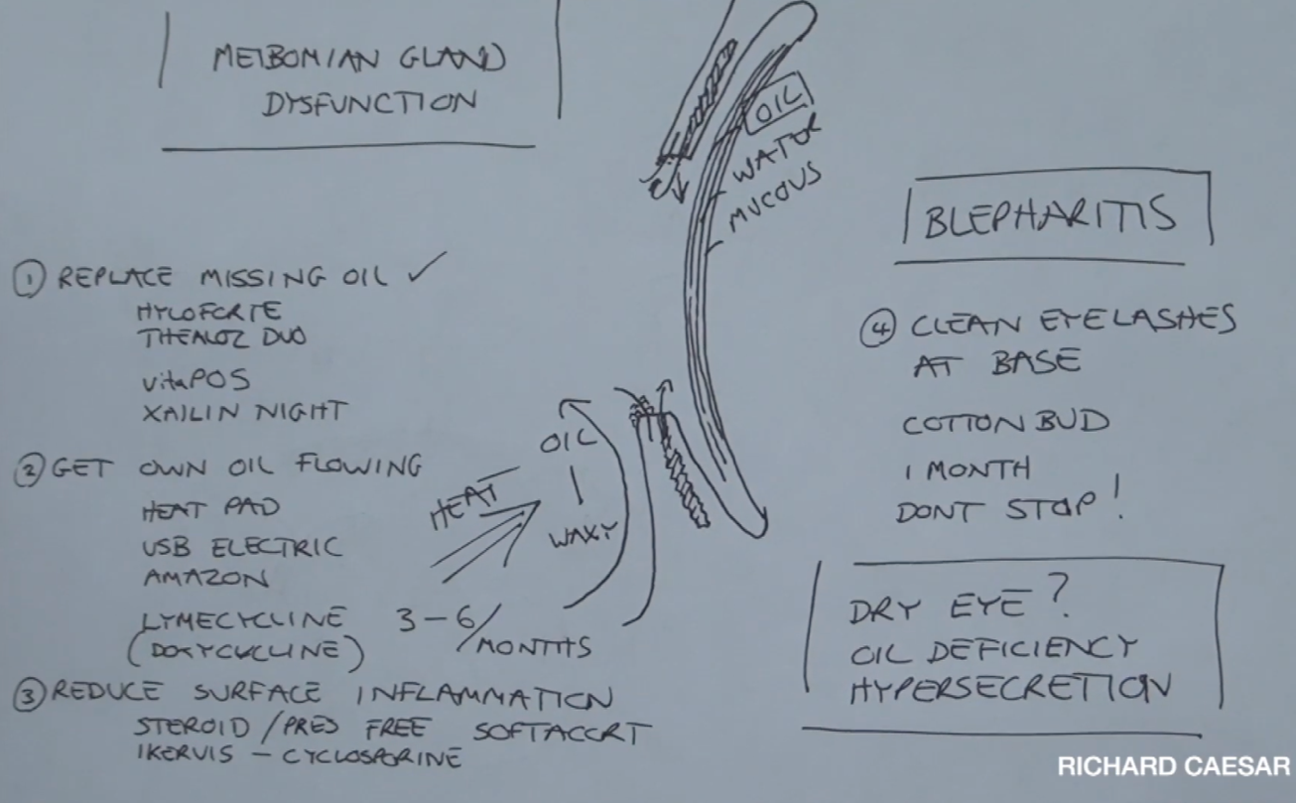
Meibomian gland dysfunction

Slide 30
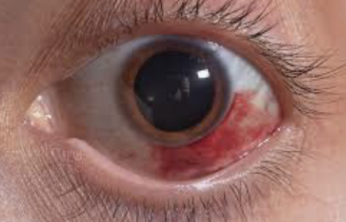
Sub-conjunctival haemorrhage
Invariably benign
What may you need to check (or ask the GP to check)?

Slide 31
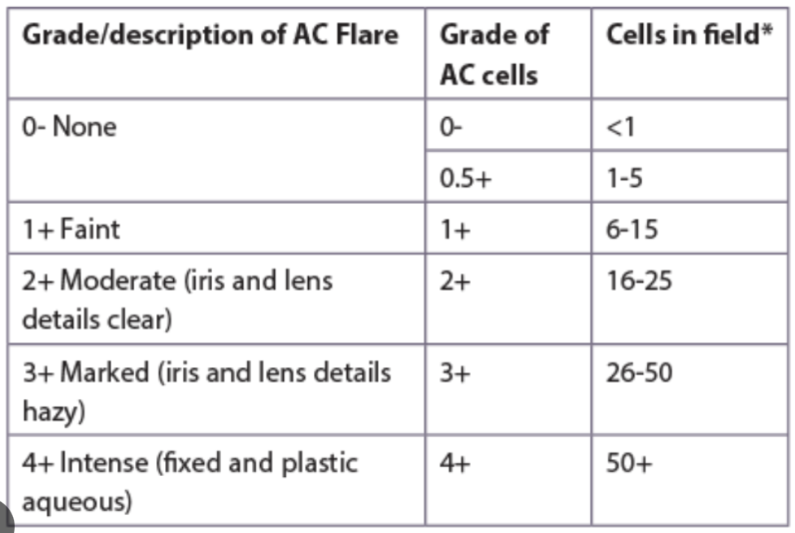
Anterior Uveitis
Standardisation of Uveitis Nomenclature (SUN)
What grading systems do you know?
Grading of anterior chamber cells and flare

Slide 32
What types of corneal ulceration (microbial keratitis) may present in CUES?E?

Slide 33
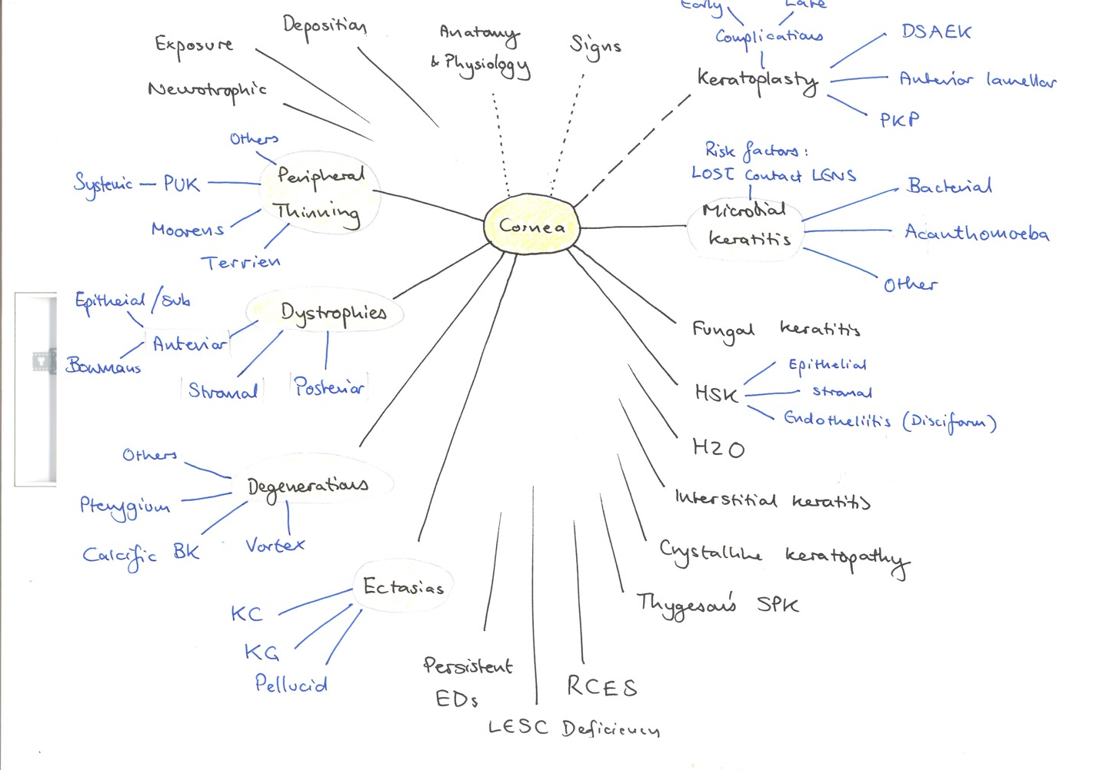

Slide 34
Microbial Keratitis

Slide 35
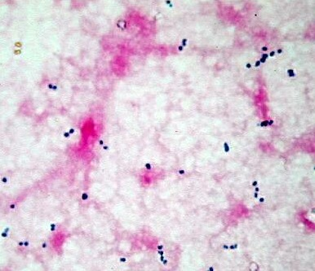
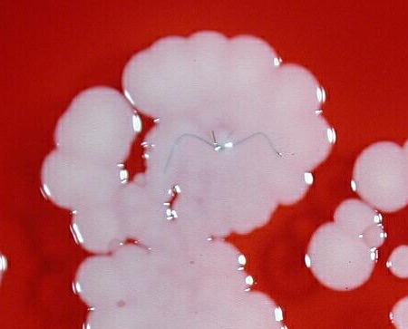
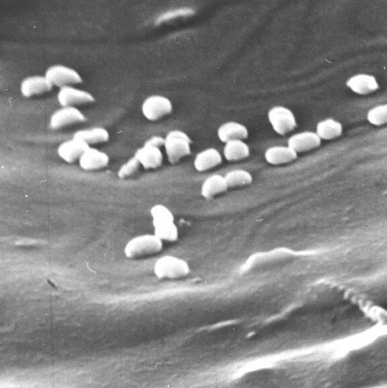
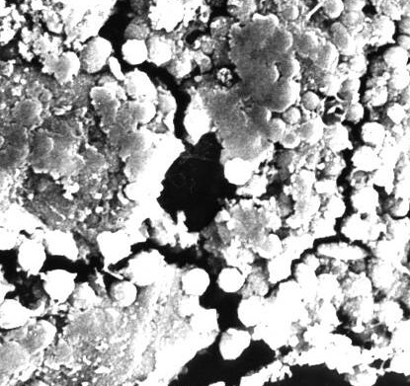
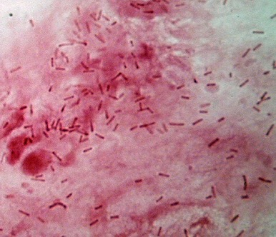
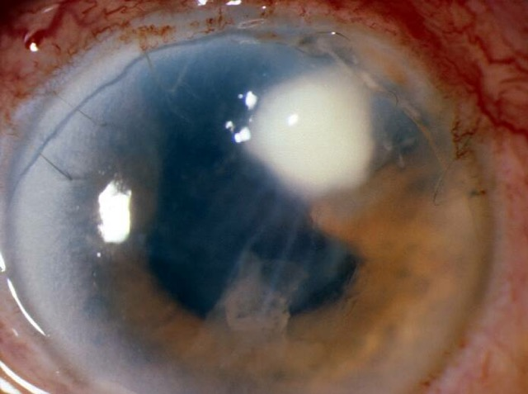
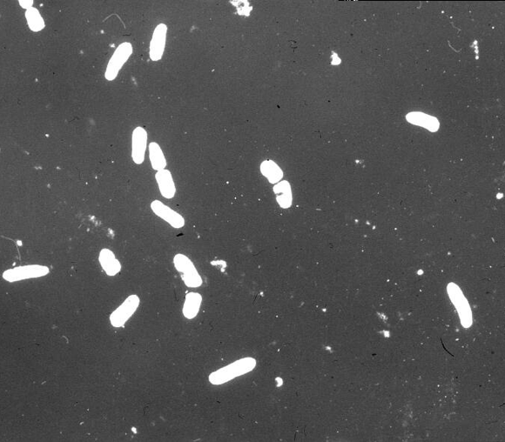
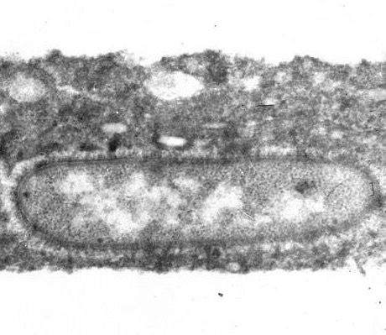
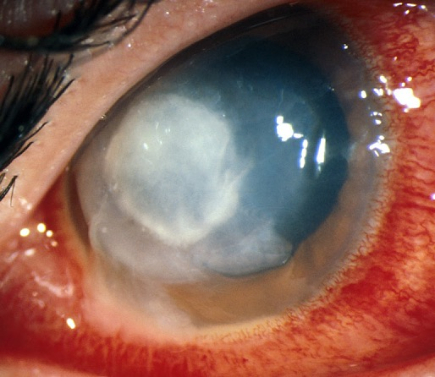
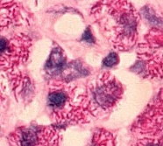
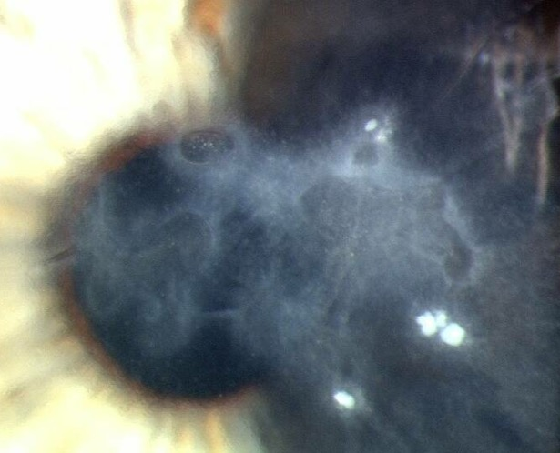
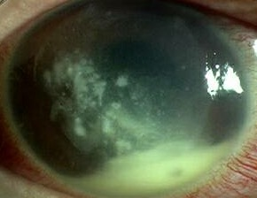
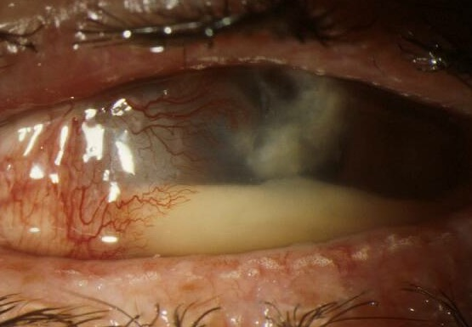
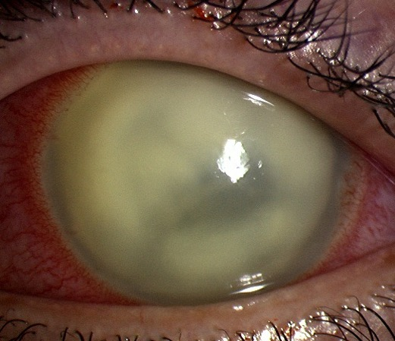
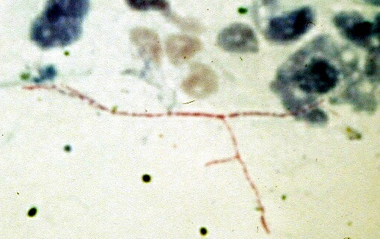
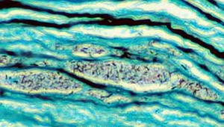
Bacteria
Fungi
Protozoa
>Causative organisms
Aerobic bacteria
Gram positive
Gram negative
Mycobacteria
Anaerobic bacteria
Nocardia
Capnocytophaga
Propionobacterium

Slide 36
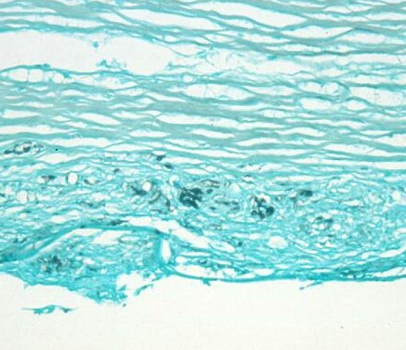
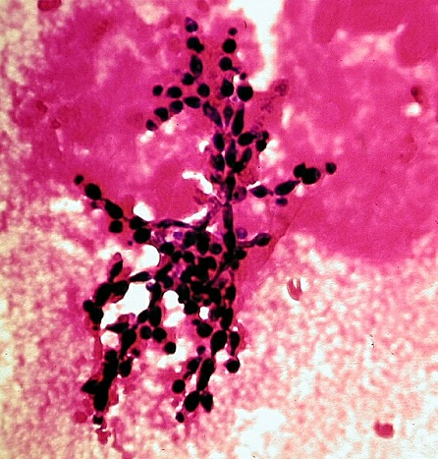
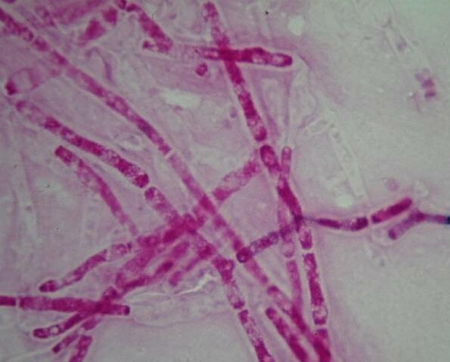
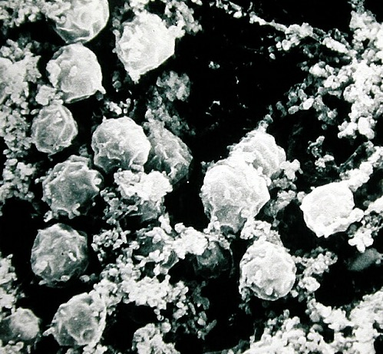
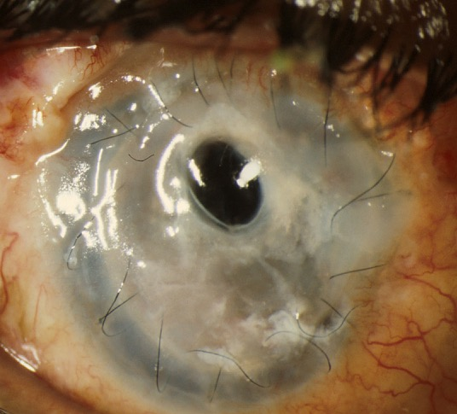
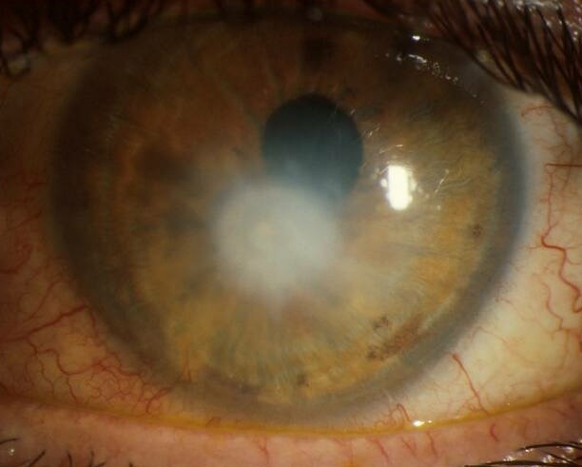
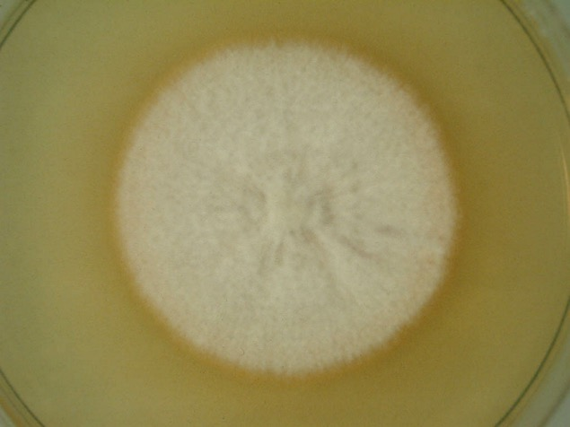
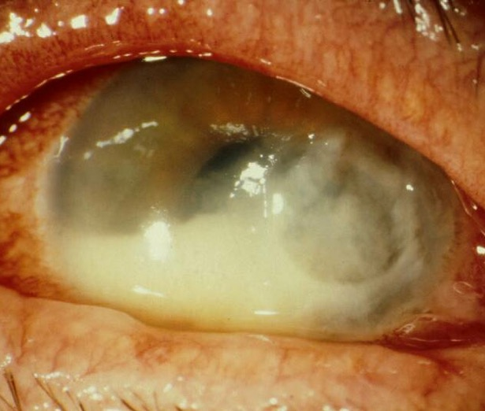
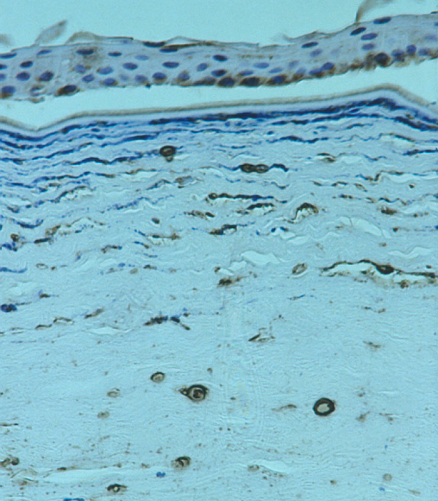
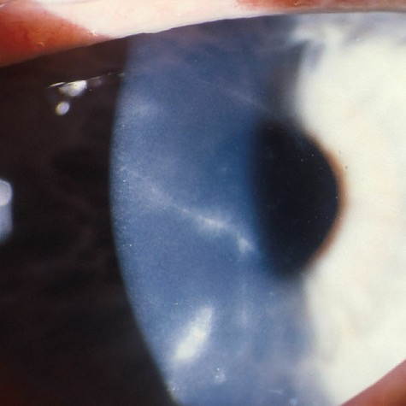
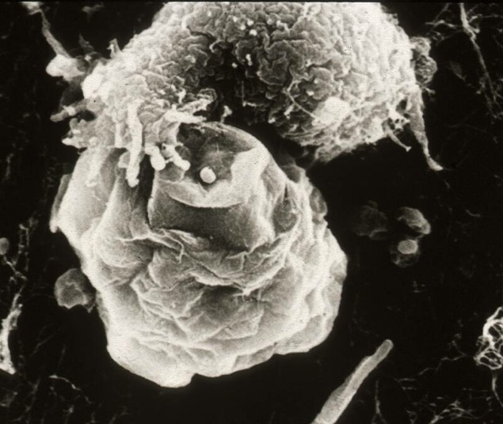
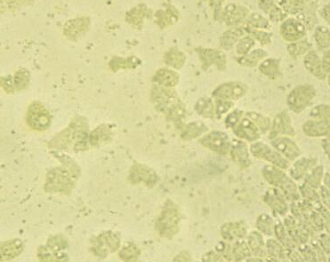
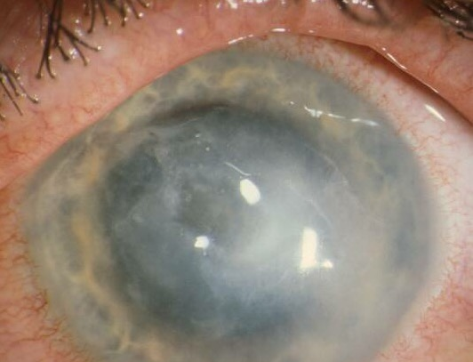
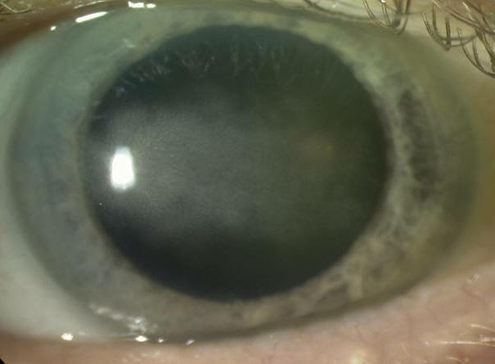


>Causative organisms
Fungi
Filamentary fungi
Yeasts
Protozoa
Acanthamoeba
Microsporidia
Herpes
Most of these result in similar lesions BUT differentiation is critical to Rx

Slide 37








Microbial Keratitis
>Principal causes of keratitis in the UK
Major causes:
Trauma
CL use 22 (41.5%)
Trauma & surgery 5 (9.4%)
Surface disease 22 (41.5%)
Miscellaneous 4 (7.5%)
Surface disease
CL related
Miscellaneous

Slide 38



Microbial Keratitis
>How to diagnose it
1 Predisposing factors
Time course
Protozoa
Contact lens use Contaminated trauma
Subacute (1-7 days)
HSV
Often relapsing
Subacute
Bacteria
Contact lens use Surface disease & Surgery
Acute (1-2 days)
Fungi
Trauma Immuno-suppressed
Variable acute to subacute
2 Characteristic clinical features
3 Microscopy
Gm+ focal
Gm- diffuse

Slide 39
GHNHS Microbial Keratitis Guidelines - History
Timing Speed of onset
Contact lens wear Soft/RGP/other
Extended Wear/Daily/weekly/biweekly/monthly disposable
History of water exposure:
showering, swimming, other water exposure risks (canoeing, diving etc…)
Ocular history Trauma
Pre-existing corneal disease/corneal Surgery
Recent topical antibiotic use
Medical history History of immunodeficiency
Patients with systemic or local immunosuppression may not show the typical signs of microbial keratitis; there may be little or no infiltration with only an epithelial defect despite active infection.

Slide 40
GHNHS Microbial Keratitis Guidelines - Examination
Visual acuity
Conjunctival Hyperaemia +/- scleritis
Size and location of infiltrate
Size and location of epithelial defect
Corneal oedema
Keratitis Precipitates
Hypopyon size and shape
Anterior Segment imaging and Anterior Segment
OCT should be performed to help with future monitoring.

Slide 41
What anterior segment post-cataract surgery conditions may present in CUES?E?

Slide 42





Post-operative
Conjunctiva
Cornea
Anterior chamber
Uvea
Lens
Endophthalmitis
VITRITIS!

Slide 43
Urgent Contact Details
Telephone Gloucestershire Hospitals NHS Emergency Eye Care Triage:
0300 422 3578
ghn-tr.geecs@nhs.net
SpaMedica patient post-op emergencies: 0330 058 4280
NewMedica patients needing immediate advice for serious issues should call 01452 596 616 or the out-of-hours number 0300 303 4053
Adequate clinical assessment & referral

Slide 44

Urgent Contact Details
Private cataract surgery - first port of call should be private secretary
Jo – 07306 889765
Nikki – 07943 4423876
Jo Dean
Private Secretary to Mr Will Dean, Consultant Ophthalmic Surgeon
Tel : 07306 889765
Nikki Longden
Private Patient Secretary to Mr Will Dean, Consultant Ophthalmic Surgeon
Contact: 07943 423987

Slide 45
Mr Will Dean PhD FRCOphth MEd MBChB Bsc
Thank you!
Consultant Ophthalmic Surgeon
Gloucestershire Hospitals NHS Foundation Trust
Tetbury Hospital Trust
Private Clinics and Cataract Surgery in Cheltenham and Tetbury
contact@cotswoldcataract.co.uk

